Slide 1

Group 10: Hacking
Charles Samuel, Levi Sutton, Romelle Green

Slide 2

Do you believe hacking can be ethical?

Slide 3

Ethical Hacking (White hat)
Hackers locate weaknesses and vulnerabilities of a computer system. Unlike malicious hackers, ethical hackers break into systems legally and ethically
There is a community of hackers that follow a code of conduct, which include:
Asking for explicit from the party to be probed
Respecting the parties privacy
Ensuring that there are not open avenues for malicious hackers to enter the system
They must alert the organization/individual if there are any vulnerabilities they have found

Slide 4


Unethical Hacking (Black Hat)
A hacker who infiltrates a computer system for malicious or personal gain.
Example: A hacking group known as Lizard Squad launched a DDOS attack on PSN and Xbox users that prevented them from playing their games online.

Slide 5

Sujeet Shenoi
Professor Shenoi at the University of Tulsa, teaches classes on hacking.
Obtains permission from energy companies for his students to attempt to hack into them, infiltrating the systems that run gas pipelines or power grids and gaining access to critical U.S. infrastructure.
Teaches students to write things like Stuxnet

Slide 6
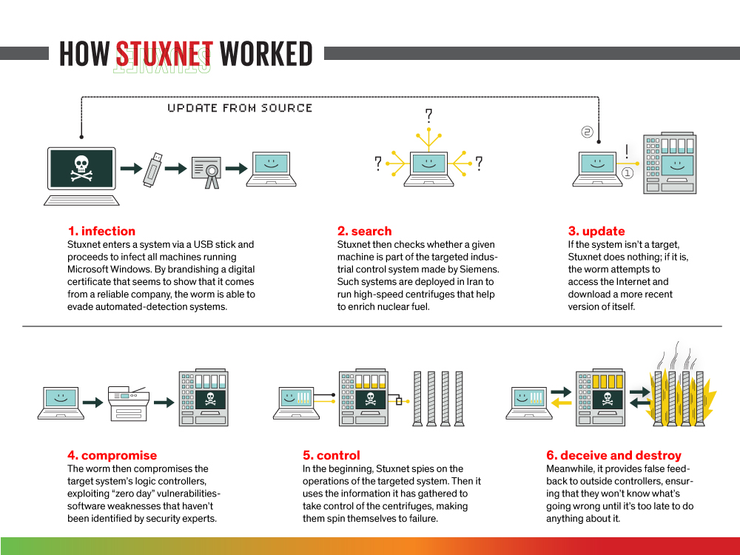
Stuxnet
Considered to be the first true use of a cyber weapon
It’s a computer worm that targets control systems and effects machinery such as assembly lines, centrifuges for separating nuclear material, etc.
Caused significant damage to Iran's nuclear program in 2010, by damaging 1,000 centrifuges which delayed their program significantly

Slide 7

Do you think teaching advanced hacking techniques are beneficial or a bad idea?

Slide 8
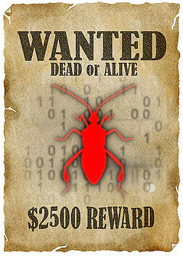
Bug Bounty
Is a crowdsourcing initiative that rewards for discovering and reporting software bugs.
- Vulnerability rewards program(VRP):
2013: Facebook- paid 20k to a researcher from the UK that found a bug that hackers could use to take over user accounts
2018: 1Password - Launched a bounty program to find security vulnerabilities on their site. They will award you $5,000 per vulnerability and can receive up to $100,000
2018: Microsoft - Vulnerability reports on identity services, including Microsoft Account, Azure Active Directory, or select OpenID standards. Offer up to $100,000

Slide 9

Hacktivism
Hacktivism is the use of technology to promote a political agenda and/or social issue.

Slide 10
Ashley Madison
Ashley Madison was an online site that allowed married couples to engage in extramarital affairs
In 2015 a group known as The Impact Team hacked and obtained personal information of the entire user base, and in mid-August the released 10 gigabytes of data that included personal information like the person’s real name, address, credit card transactions, and search history. This amounts to over 30 million people in over 40 countries.
This group wanted Avid Life Media, the parent company of Ashley Madison to shutdown the site because it was morally wrong
The company stated it was only providing a service that was in demand

Slide 11
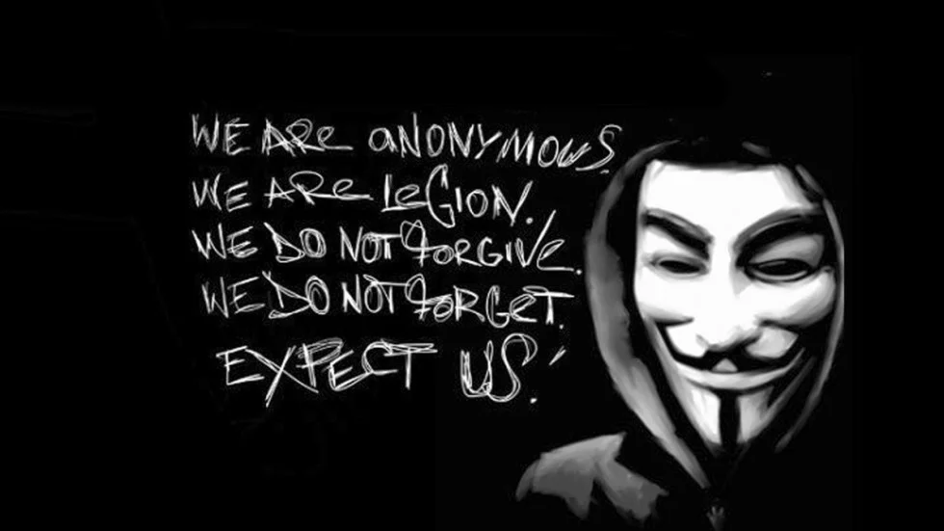
Anonymous vs Islamic State
The group Anonymous claims to be at war with ISIS
They systematically hack into the social media accounts of members and followers, and take down propaganda websites
In 2016 an Anonymous hacker hacked into ISIS members Twitter account and revamped their homepage displaying pro gay materiaal. Happened after the Orlando terrorist attack

Slide 12
Hacking for Social Change
Protests and demonstration are the most common methods used to bring about change. They have contributed to change in major ways in history
“Try to imagine the organization of an event 20 years ago, and compare it with what is happening today. Just one tweet, a picture, can blow the wind into a revolution”
Cybersecurity expert, cybercrime analyst, and author Pierluigi Paganini
There is a new tool being used to bring about change. Hacking may be just as powerful as these methods
Controversial method of bringing about change

Slide 13
Hacking for Social Change cont.
Could hacktivism have a long term effects on society?
Concerns: After events such as hackathons that raise awareness about certain issues, individuals will forget about the issue
Solution: longer lasting projects

Slide 14
The Thin Line Between Hacktivism and Ethical Hacking
What is considered an ethical reason for Hacking?
Ethical hacking?
Example : Penetration testing made within the organization in order to promote better security practices
Hacktivism?
Example: Penetration of a corrupt organization to expose corruption
Depending on the person, either could be considered ethical.

Slide 15
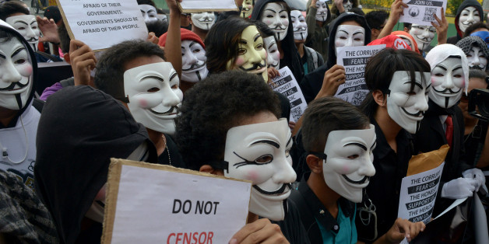
Is hacktivism an ethical way to bring about social change?

